Slide 1
Polynomials and Polynomial Functions
Algebra 2
Chapter 5
Notes:
Algebra II 5

Slide 2
This Slideshow was developed to accompany the textbook
  Larson Algebra 2
  By Larson, R., Boswell, L., Kanold, T. D., & Stiff, L.
  2011 Holt McDougal
Some examples and diagrams are taken from the textbook.
Slides created by
Richard Wright, Andrews Academy
rwright@andrews.edu

Slide 3
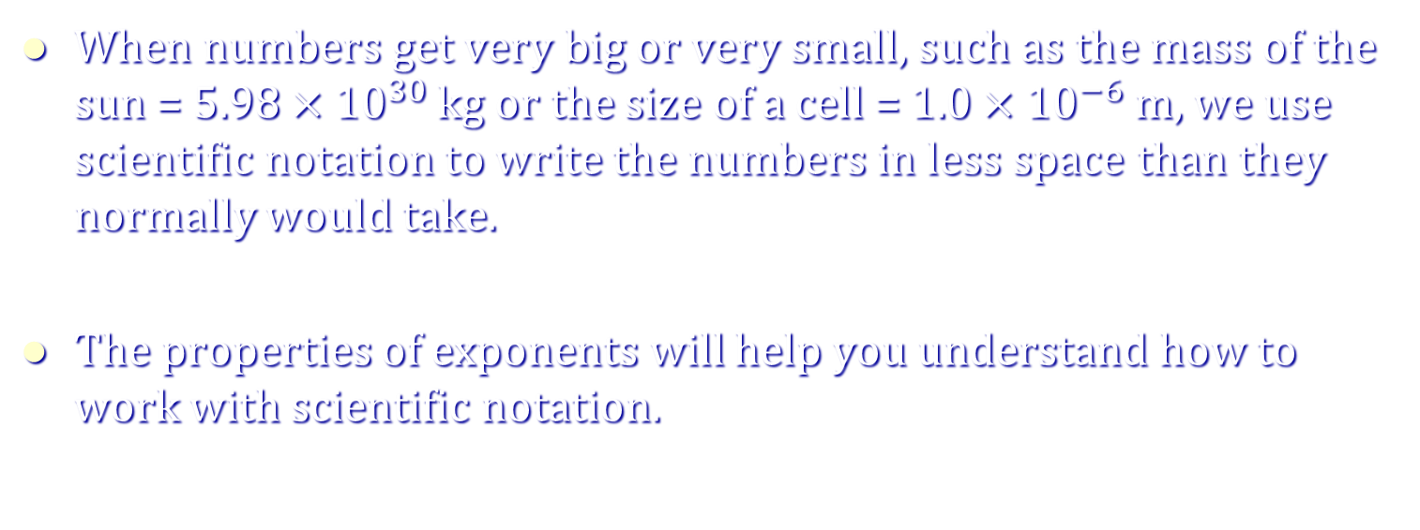
5.1 Use Properties of Exponents
When numbers get very big or very small, such as the mass of the sun = $5.98×{10}^{30}$ kg or the size of a cell = $1.0×{10}^{−6}$ m, we use scientific notation to write the numbers in less space than they normally would take.
The properties of exponents will help you understand how to work with scientific notation.

Slide 4
5.1 Use Properties of Exponents
What is an exponent and what does it mean?
  A superscript on a number.
  It tells the number of times the number is multiplied by itself.
Example;
  x³ = x x x
Base
Exponent

Slide 5
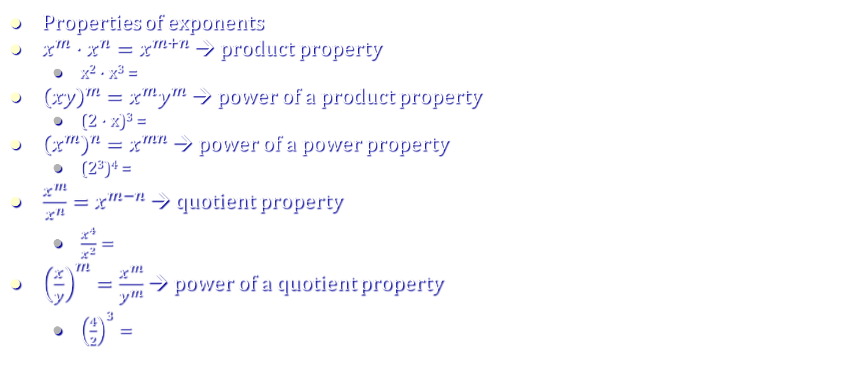
5.1 Use Properties of Exponents
Properties of exponents
$x^{m}⋅x^{n}=x^{m+n}$ → product property
  x² · x³ =
${\left(xy\right)}^{m}=x^{m}y^{m}$ → power of a product property
  (2 · x)³ =
${\left(x^{m}\right)}^{n}=x^{mn}$ → power of a power property
  (2³)⁴ =
$\frac{x^{m}}{x^{n}}=x^{m−n}$ → quotient property
  $\frac{x^{4}}{x^{2}}=$
${\left(\frac{x}{y}\right)}^{m}=\frac{x^{m}}{y^{m}}$ → power of a quotient property
  ${\left(\frac{4}{2}\right)}^{3}=$
Notes:
(x x)(x x x) = x² ⁺ ³ = x⁵
6³ = 216; 2³ · 3³ = 8 · 27 = 216
(2 · 2 · 2)⁴ = 2⁴ · 2⁴ · 2⁴ = 16 · 16 · 16 = 4096; (2³)⁴ = 2¹² = 4096
(x x x x)/(x x) = x x = x²; x⁴ / x² = x⁴⁻² = x²
2³ = 8; (4/2)³ = 4³/2³ = 64/8 = 8

Slide 6
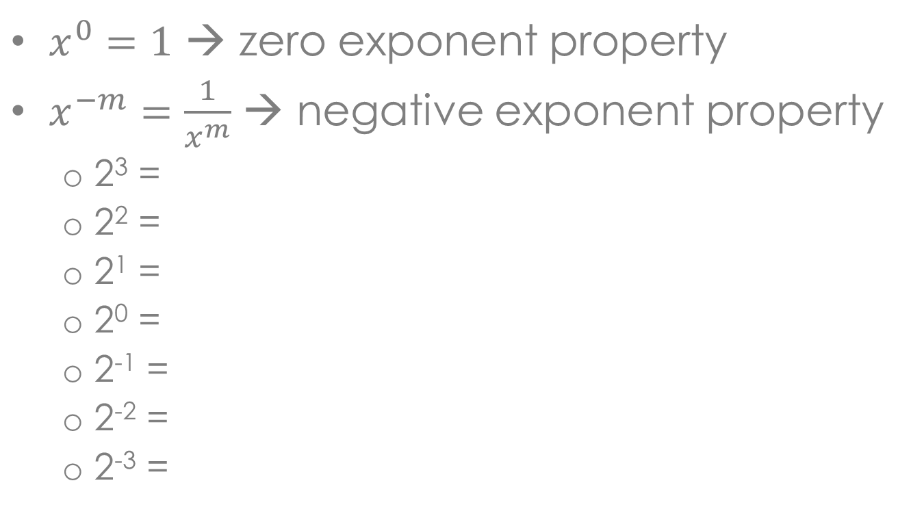
5.1 Use Properties of Exponents
$x^{0}=1$ → zero exponent property
$x^{−m}=\frac{1}{x^{m}}$ → negative exponent property
  2³ =
  2² =
  2¹ =
  2⁰ =
  2⁻¹ =
  2⁻² =
  2⁻³ =
Notes:
2 2 2 = 8
2 2 = 4
2 = 2
1
½
1/( 2 2) = ¼
1/(2 2 2) = 1/8

Slide 7
5.1 Use Properties of Exponents
5⁻⁴ 5³ =
((-3)²)³ =
(3²x²y)² =
Notes:
(-3)⁶ = 729
3⁴x⁴y² = 81x⁴y²
5⁻⁴ ⁺ ³ = 5⁻¹ = 1/5

Slide 8
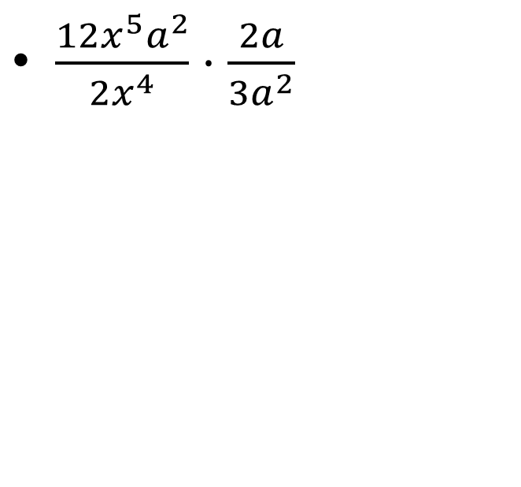
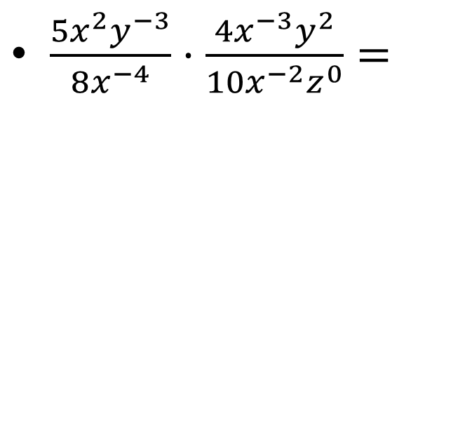
5.1 Use Properties of Exponents
$\frac{12x^{5}a^{2}}{2x^{4}}⋅\frac{2a}{3a^{2}}$
$\frac{5x^{2}y^{−3}}{8x^{−4}}⋅\frac{4x^{−3}y^{2}}{10x^{−2}z^{0}}=$
Notes:
(5x²x⁴)/(8y³)*(4x²y²)/(10x³1) = (20x⁸y²)/(80x³y³) = x⁵/4y
(24x⁵a³)/(6x⁴a²) = 4xa

Slide 9
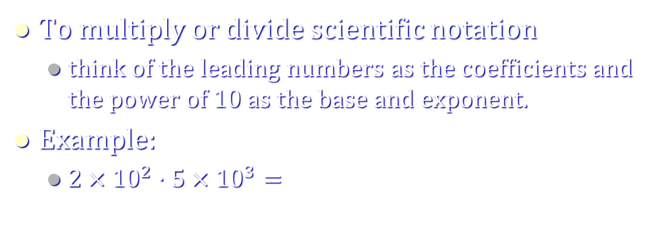
5.1 Use Properties of Exponents
To multiply or divide scientific notation
  think of the leading numbers as the coefficients and the power of 10 as the base and exponent.
Example:
  $2×{10}^{2}⋅5×{10}^{3}=$
Notes:
10x10²⁺³ = 10x10⁵ = 1x10⁶

Slide 10
Homework Quiz
5.1 Homework Quiz

Slide 11
5.2 Evaluate and Graph Polynomial Functions
Large branches of mathematics spend all their time dealing with polynomials.
They can be used to model many complicated systems.

Slide 12
5.2 Evaluate and Graph Polynomial Functions
Polynomial in one variable
  Function that has one variable and there are powers of that variable and all the powers are positive
4x³ + 2x² + 2x + 5
100x¹²³⁴ – 25x³⁴⁵ + 2x + 1
2/x
3xy²
Not Polynomials in one variable.

Slide 13
5.2 Evaluate and Graph Polynomial Functions
Degree
  Highest power of the variable
What is the degree?
  4x³ + 2x² + 2x + 5
Notes:
3

Slide 14
5.2 Evaluate and Graph Polynomial Functions
Types of Polynomial Functions
Degree → Type
  0 → Constant → y = 2
  1 → Linear → y = 2x + 1
  2 → Quadratic → y = 2x² + x – 1
  3 → Cubic → y = 2x³ + x² + x – 1
  4 → Quartic → y = 2x⁴ + 2x² – 1

Slide 15
5.2 Evaluate and Graph Polynomial Functions
Functions
  f(x) = 4x³ + 2x² + 2x + 5 means that this polynomial has the name f and the variable x
  f(x) does not mean f times x!
Direct Substitution
  Example: find f(3)
Notes:
ANS: the x was replaced by the 3, so in the polynomial replace the x with 3 and simplify.
f(3) = 4(3)³ + 2(3)² + 2(3) + 5 ➔ 4(27) + 2(9) + 6 + 5 ➔ 108 + 18 + 11 ➔ 137

Slide 16
5.2 Evaluate and Graph Polynomial Functions
Synthetic Substitution
  Example: find f(2) if f(y) = -y⁶ + 4y⁴ + 3y² + 2y
f(2) = 16
Coefficients with placeholders
2
-
1
0
4
0
3
2
0
-
2
-
4
0
0
6
16
-
1
-
2
0
0
3
8
16

Slide 17
5.2 Evaluate and Graph Polynomial Functions
End Behavior
  Polynomial functions always go towards ∞ or -∞ at either end of the graph
Write
  f(x) → +∞ as x → -∞ and f(x) → +∞ as x → +∞
 | Leading Coefficient + | Leading Coefficient -
Even Degree
Odd Degree
Notes:
(this is for even degree with positive first term)

Slide 18
5.2 Evaluate and Graph Polynomial Functions
Graphing polynomial functions
  Make a table of values
  Plot the points
  Make sure the graph matches the appropriate end behavior

Slide 19
5.2 Evaluate and Graph Polynomial Functions
Graph f(x) = x³ + 2x – 4
Notes:
Make table, points are (-3, -37), (-2, -16), (-1, -7), (0, -4), (1, -1), (2, 8), (3, 29)

Slide 20
Homework Quiz
5.2 Homework Quiz

Slide 21
5.3 Add, Subtract, and Multiply Polynomials
Adding, subtracting, and multiplying are always good things to know how to do.
Sometimes you might want to combine two or more models into one big model.

Slide 22
5.3 Add, Subtract, and Multiply Polynomials
Adding and subtracting polynomials
  Add or subtract the coefficients of the terms with the same power.
  Called combining like terms.
Examples:
  (5x² + x – 7) + (-3x² – 6x – 1)
  (3x³ + 8x² – x – 5) – (5x³ – x² + 17)
Notes:
2x² – 5x – 8
-2x³ + 9x² – x – 22

Slide 23
5.3 Add, Subtract, and Multiply Polynomials
Multiplying polynomials
  Use the distributive property
Examples:
  (x – 3)(x + 4)
  (x + 2)(x² + 3x – 4)
Notes:
x(x + 4) – 3(x + 4) → x² + 4x – 3x – 12 → x² + x – 12
→ x(x² + 3x – 4) + 2(x² + 3x – 4) → x³ + 3x² – 4x + 2x² + 6x – 8 → x³ + 5x² + 2x – 8

Slide 24
5.3 Add, Subtract, and Multiply Polynomials
(x – 1)(x + 2)(x + 3)
Notes:
→ (x(x + 2) – 1(x + 2))(x + 3) → (x² + 2x – 1x – 2)(x + 3) → (x² + x – 2)(x +3) → x²(x + 3) + x(x + 3) – 2(x + 3) → x³ + 3x² + x² + 3x – 2x – 6 → x³ + 4x² + x – 6

Slide 25
5.3 Add, Subtract, and Multiply Polynomials
Special Product Patterns
  Sum and Difference
    (a – b)(a + b) = a² – b²
  Square of a Binomial
    (a ± b)² = a² ± 2ab + b²
  Cube of a Binomial
    (a ± b)³ = a³ ± 3a²b + 3ab² ± b³

Slide 26
5.3 Add, Subtract, and Multiply Polynomials
(x + 2)³
(x – 3)²
Notes:
→ x² – 2(3)x + 3² → x² – 6x + 9
→ x³ + 3x²(2) + 3x2² + 2³ → x³ + 6x² + 12x + 8

Slide 27
Homework Quiz
5.3 Homework Quiz

Slide 28
5.4 Factor and Solve Polynomial Equations
A manufacturer of shipping cartons who needs to make cartons for a specific use often has to use special relationships between the length, width, height, and volume to find the exact dimensions of the carton.
The dimensions can usually be found by writing and solving a polynomial equation.
This lesson looks at how factoring can be used to solve such equations.

Slide 29
5.4 Factor and Solve Polynomial Equations
How to Factor
Greatest Common Factor
  Comes from the distributive property
  If the same number or variable is in each of the terms, you can bring the number to the front times everything that is left.
  3x²y + 6xy –9xy² =
  Look for this first!
Notes:
3xy(x + 2 – y)

Slide 30
5.4 Factor and Solve Polynomial Equations
Check to see how many terms
  Two terms
    Difference of two squares: a² – b² = (a – b)(a + b)
      9x² – y⁴ =
    Sum of Two Cubes: a³ + b³ = (a + b)(a² – ab + b²)
      8x³ + 27 =
    Difference of Two Cubes: a³ – b³ = (a – b)(a² + ab + b²)
      y³ – 8 =
Notes:
(3x – y²)(3x + y²)
(2x + 3)(4x² – 6x + 9)
(y – 2)(y² + 2y + 4)

Slide 31
5.4 Factor and Solve Polynomial Equations
Three terms
  General Trinomials → ax² + bx + c
  Write two sets of parentheses ( )( )
  Guess and Check
  The Firsts multiply to make ax²
  The Lasts multiply to make c
  The Outers + Inners make bx
    x² + 7x + 10 =
    x² + 3x – 18 =
    6x² – 7x – 20 =
Notes:
(x+2)(x+5)
(x – 3)(x + 6)
(2x – 5)(3x + 4)

Slide 32
5.4 Factor and Solve Polynomial Equations
Four terms
  Grouping
    Group the terms into sets of two so that you can factor a common factor out of each set
    Then factor the factored sets (Factor twice)
    b³ – 3b² – 4b + 12 =
Notes:
(b³ – 3b²) + (-4b + 12) = b²(b – 3) + -4(b – 3) = (b – 3)(b² - 4)

Slide 33
5.4 Factor and Solve Polynomial Equations
Try factoring more!
Examples:
  a²x – b²x + a²y – b²y =
Notes:
x(a² – b²) + y(a² – b²) = (x + y)(a² – b²) = (x + y)(a – b)(a + b)

Slide 34
5.4 Factor and Solve Polynomial Equations
3a²z – 27z =
n⁴ – 81 =
Notes:
3z(a² – 9) = 3z(a – 3)(a + 3)
(n² – 9)(n² + 9) = (n² + 9)(n – 3)(n + 3)

Slide 35
5.4 Factor and Solve Polynomial Equations
Solving Equations by Factoring
  Make = 0
  Factor
  Make each factor = 0 because if one factor is zero, 0 time anything = 0

Slide 36
5.4 Factor and Solve Polynomial Equations
2x⁵ = 18x
Notes:
ANS: 2x⁵ – 162x = 0 → 2x(x⁴ – 81) = 0 → 2x(x² – 9)(x² + 9) = 0 → 2x(x – 3)(x + 3)(x² + 9) = 0 → 2x = 0, x – 3 = 0, x + 3 = 0, x² + 9 = 0 → x = 0, 3, -3

Slide 37
Homework Quiz
5.4 Homework Quiz

Slide 38
5.5 Apply the Remainder and Factor Theorems
So far we done add, subtracting, and multiplying polynomials.
Factoring is similar to division, but it isn’t really division.
Today we will deal with real polynomial division.

Slide 39
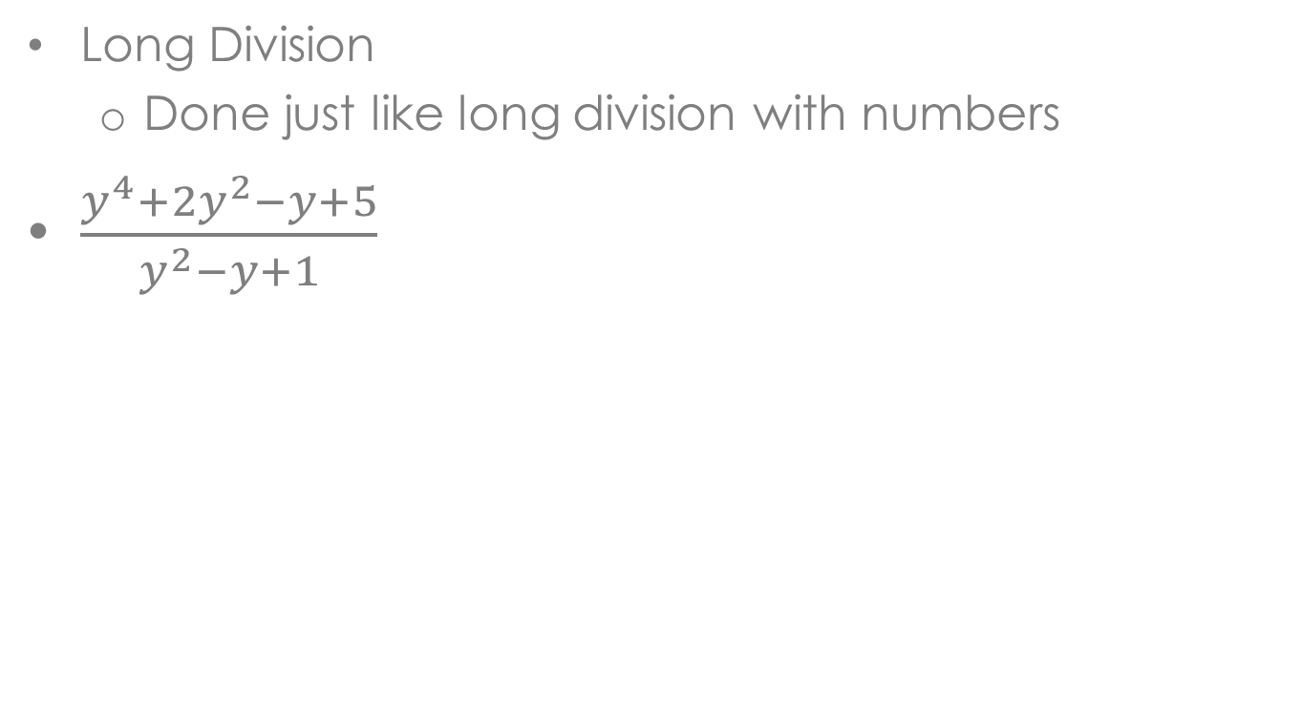
5.5 Apply the Remainder and Factor Theorems
Long Division
  Done just like long division with numbers
$\frac{y^{4}+2y^{2}−y+5}{y^{2}−y+1}$

Slide 40

5.5 Apply the Remainder and Factor Theorems
$\frac{x^{3}+4x^{2}−3x+10}{x+2}$
Notes:
$$x^{2}+2x−7+\frac{24}{x+2}$$

Slide 41
5.5 Apply the Remainder and Factor Theorems
Synthetic Division
  Shortened form of long division for dividing by a binomial
  Only when dividing by (x – r)

Slide 42

5.5 Apply the Remainder and Factor Theorems
Synthetic Division
  Example: (-5x⁵ -21x⁴ –3x³ +4x² + 2x +2) / (x + 4)
Coefficients with placeholders
-4
-
5
-21
-3
4
2
2
20
4
-4
0
-8
-
5
-
1
1
0
2
-6
$$−5x^{4}−x^{3}+x^{2}+2+\frac{−6}{x+4}$$

Slide 43
5.5 Apply the Remainder and Factor Theorems
(2y⁵ + 64)(2y + 4)⁻¹
y⁴ – 2y³ + 4y² – 8y + 16
-2
1
0
0
0
0
32
-2
4
-8
16
-32
1
-
2
4
-8
16
0

Slide 44
5.5 Apply the Remainder and Factor Theorems
Remainder Theorem
  if polynomial f(x) is divided by the binomial (x – a), then the remainder equals f(a).
  Synthetic substitution
  Example: if f(x) = 3x⁴ + 6x³ + 2x² + 5x + 9, find f(9)
    Use synthetic division using (x – 9) and see remainder.

Slide 45
5.5 Apply the Remainder and Factor Theorems
The Factor Theorem
  The binomial x – a is a factor of the polynomial f(x) iff f(a) = 0

Slide 46
5.5 Apply the Remainder and Factor Theorems
Using the factor theorem, you can find the factors (and zeros) of polynomials
Simply use synthetic division using your first zero (you get these off of problem or off of the graph where they cross the x-axis)
The polynomial answer is one degree less and is called the depressed polynomial.
Divide the depressed polynomial by the next zero and get the next depressed polynomial.
Continue doing this until you get to a quadratic which you can factor or use the quadratic formula to solve.

Slide 47
5.5 Apply the Remainder and Factor Theorems
Show that x – 2 is a factor of x³ + 7x² + 2x – 40. Then find the remaining factors.
Notes:
All factors are (x + 4)(x + 5)(x – 2)

Slide 48
Homework Quiz
5.5 Homework Quiz

Slide 49
5.6 Find Rational Zeros
Rational Zero Theorem
  Given a polynomial function, the rational zeros will be in the form of p/q where p is a factor of the last (or constant) term and q is the factor of the leading coefficient.

Slide 50
5.6 Find Rational Zeros
List all the possible rational zeros of
f(x) = 2x³ + 2x² - 3x + 9
Notes:
ANS: p = 1, 3, 9; q = 1, 2 → ±1, ±1/2, ±3, ±3/2, ±9, ±9/2

Slide 51
5.6 Find Rational Zeros
Find all rational zeros of f(x) = x³ - 4x² - 2x + 20
Notes:
ANS: List possible rational roots; ±1, ±2, ±4, ±5, ±10, ±20
If there are many zeros you many want to graph to choose which roots to try
Lets look for the negative first. Use a table a shortened form of synthetic division
Since the remainder was zero -2 is a root and the depressed polynomial is x² – 6x + 10
Repeat the process on the depressed polynomial until you get a quadratic for the depressed polynomial then use the quadratic formula
x = 3 ± i, -2

Slide 52
Homework Quiz
5.6 Homework Quiz

Slide 53
5.7 Apply the Fundamental Theorem of Algebra
When you are finding the zeros, how do you know when you are finished?
Today we will learn about how many zeros there are for each polynomial function.

Slide 54
5.7 Apply the Fundamental Theorem of Algebra
Fundamental Theorem of Algebra
  A polynomial function of degree greater than zero has at least one zero.
  These zeros may be imaginary however.
  There is the same number of zeros as there is degree – you may have the same zero more than once though.
    Example x² + 6x + 9=0 → (x + 3)(x + 3)=0 →zeros are -3 and -3

Slide 55
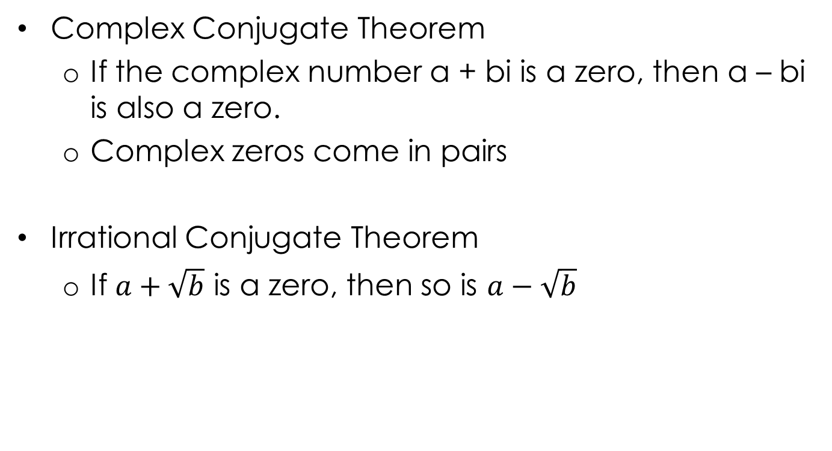
5.7 Apply the Fundamental Theorem of Algebra
Complex Conjugate Theorem
  If the complex number a + bi is a zero, then a – bi is also a zero.
  Complex zeros come in pairs
Irrational Conjugate Theorem
  If $a+\sqrt{b}$ is a zero, then so is $a−\sqrt{b}$

Slide 56

5.7 Apply the Fundamental Theorem of Algebra
Given a function, find the zeros of the function.
$f\left(x\right)=x^{3}–7x^{2}+16x–10$
Notes:
Find p’s, q’s, and p/q
Choose a p/q (1 works well)
Use synthetic division to check to see if it is a factor (it is)
The depressed polynomial is a quadratic, so use the quadric formula to solve.
The zeros are 1, 3 ± i

Slide 57
5.7 Apply the Fundamental Theorem of Algebra
Write a polynomial function that has the given zeros. 2, 4i
Notes:
ANS: (x – 2)(x – 4i)(x + 4i) Don’t forget -4i is also a root.
(x – 2)(x² – 16i²) → (x – 2)(x² + 16) → x³ -2x² + 16x - 32

Slide 58
5.7 Apply the Fundamental Theorem of Algebra
Descartes’ Rule of Signs
  If f(x) is a polynomial function, then
    The number of positive real zeros is equal to the number of sign changes in f(x) or less by even number.
    The number of negative real zeros is equal to the number of sign changes in f(-x) or less by even number.

Slide 59
5.7 Apply the Fundamental Theorem of Algebra
Determine the possible number of positive real zeros, negative real zeros, and imaginary zeros for g(x) = 2x⁴ – 3x³ + 9x² – 12x + 4
  Positive zeros:
    4, 2, or 0
  Negative zeros: g(-x) = 2x⁴ + 3x³ + 9x² + 12x + 4
    0
Positive | Negative | Imaginary | Total
4 | 0 | 0 | 4
2 | 0 | 2 | 4
0 | 0 | 4 | 4

Slide 60
Homework Quiz
5.7 Homework Quiz

Slide 61
5.8 Analyze Graphs of Polynomial Functions
If we have a polynomial function, then
  k is a zero or root
  k is a solution of f(x) = 0
  k is an x-intercept if k is real
  x – k is a factor

Slide 62
5.8 Analyze Graphs of Polynomial Functions
Use x-intercepts to graph a polynomial function
f(x) = ½ (x + 2)²(x – 3)
  since (x + 2) and (x – 3) are factors of the polynomial, the x-intercepts are -2 and 3
  plot the x-intercepts
  Create a table of values to finish plotting points around the x-intercepts
  Draw a smooth curve through the points

Slide 63
5.8 Analyze Graphs of Polynomial Functions
Graph f(x) = ½ (x + 2)²(x – 3)

Slide 64
5.8 Analyze Graphs of Polynomial Functions
Turning Points
  Local Maximum and minimum (turn from going up to down or down to up)
  The graph of every polynomial function of degree n can have at most n-1 turning points.
  If a polynomial function has n distinct real zeros, the function will have exactly n-1 turning points.
  Calculus lets you find the turning points easily.

Slide 65
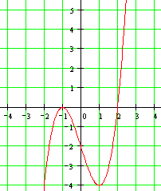
5.8 Analyze Graphs of Polynomial Functions
What are the turning points?

Slide 66
Homework Quiz
5.8 Homework Quiz

Slide 67
5.9 Write Polynomial Functions and Models
You keep asking, “Where will I ever use this?” Well today we are going to model a few situations with polynomial functions.

Slide 68
5.9 Write Polynomial Functions and Models
Writing a function from the x-intercepts and one point
  Write the function as factors with an a in front
  y = a(x – p)(x – q)…
  Use the other point to find a
Example:
  x-intercepts are -2, 1, 3 and (0, 2)
Notes:
ANS: y = a(x + 2)(x – 1)(x – 3)
2 = a(0 + 2)(0 – 1)(0 – 3) → 2 = 6a → a = 1/3
y = 1/3 (x + 2)(x – 1)(x – 3)

Slide 69
5.9 Write Polynomial Functions and Models
Show that the nth-order differences for the given function of degree n are nonzero and constant.
  Find the values of the function for equally spaced intervals
  Find the differences of the y values
  Find the differences of the differences and repeat until all are the same value

Slide 70

5.9 Write Polynomial Functions and Models
Show that the 3rd order differences are constant of
$f(x)=2x^{3}+x^{2}+2x+1$
Notes:
f(0) = 1
f(1) = 6 6-1 = 5
f(2) = 25 25-6 = 19 19 – 5 = 14
f(3) = 70 70-25 = 45 45 – 19 = 26 26-14=12
f(4) = 153 153-70 = 83 83 – 45 = 38 38-26=12
f(5) = 286 286-153 = 133 133-83 = 50 50-38=12

Slide 71
5.9 Write Polynomial Functions and Models
Finding a model given several points
  Find the degree of the function by finding the finite differences
    Degree = order of constant nonzero finite differences
  Write the basic standard form functions
  (i.e. f(x) = ax³ + bx² + cx + d
  Fill in x and f(x) with the points
  Use some method to find a, b, c, and d
    Cramer’s rule or graphing calculator using matrices or computer program

Slide 72
5.9 Write Polynomial Functions and Models
Find a polynomial function to fit:
f(1) = -2, f(2) = 2, f(3) = 12, f(4) = 28, f(5) = 50, f(6) = 78
Notes:
ANS: Find finite differences
1st order: 2 - -2 = 4, 12 – 2 = 10, 28 – 12 = 16, 50 – 28 = 22, 78 – 50 = 28
2nd order: 10 – 4 = 6, 16 – 10 = 6, 22 – 16 = 6, 28 – 22 = 6
degree = 2
f(x) = ax² + bx + c
-2 = a(1)² + b(1) + c
2 = a(2)² + b(2) + c
12 = a(3)² + b(3) + c
f(x) = 3x² – 5x

Slide 73
5.9 Write Polynomial Functions and Models
Regressions on TI Graphing Calculator
Push STAT ↓ Edit…
Clear lists, then enter x’s in 1st column and y’s in 2nd
Push STAT → CALC ↓ (regression of your choice)
Push ENTER twice
Read your answer

Slide 74
5.9 Write Polynomial Functions and Models
Regressions using Microsoft Excel
Enter x’s and y’s into 2 columns
Insert X Y Scatter Chart
In Chart Tools: Layout pick Trendline → More Trendline options
Pick a Polynomial trendline and enter the degree of your function AND pick Display Equation on Chart
Click Done
Read your answer off of the chart.

Slide 75
Homework Quiz
5.9 Homework Quiz

